Slide 1
Dulles International Airport
Reagan National Airport
Travel to the I-95 and head south towards Fredericksburg. Take exit 148 and take a right (west) at the light.
MSG School
N

Slide 2
MSG School
Exit 148
N

Slide 3
MSG Barracks/Check in Location
N

Slide 4
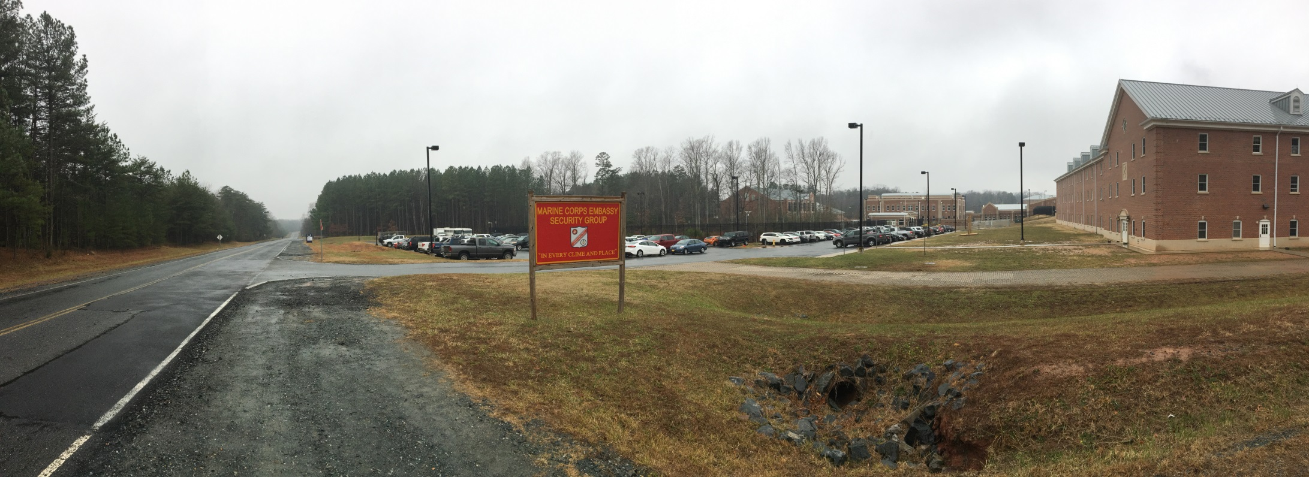
MSG Barracks/Check in Location
N

